Slide 1

Heuristics
Notes:
https://uxmag.com/articles/psychological-usability-heuristics

Slide 2
Heuristic Evaluation
Developed by Jakob Nielsen
Helps find usability problems in a UI design
Small set (3-5) of evaluators examine UI
independently check for compliance with usability principles (“heuristics”)
different evaluators will find different problems
evaluators only communicate afterwards
findings are then aggregated
Can perform on working UI or on sketches
https://www.nngroup.com/articles/ten-usability-heuristics/

Slide 3
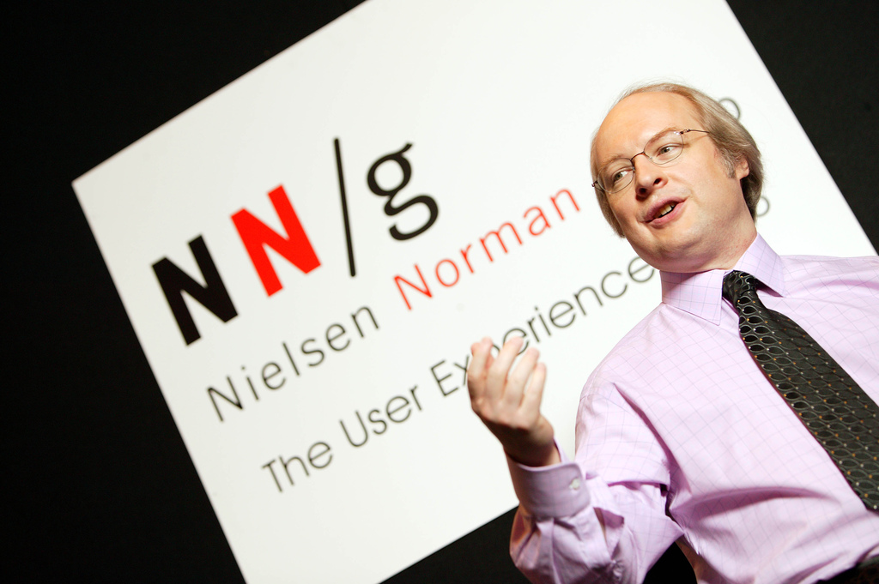



Slide 4
Phases of Heuristic Evaluation
1) Pre-evaluation training
give evaluators needed domain knowledge and information on the scenarios
2) Evaluation
individual evaluate
aggregate results
3) Severity rating
determine how severe each problem is (priority)
Individual rating first and then aggregate results
Possible solution
4) Debriefing
discuss the outcome with design team

Slide 5
Heuristics
H1: Visibility of system status
H2: Match between system and real world
H3: User control and freedom
H4: Consistency and standards
H5: Error prevention
H6: Recognition rather than recall
H7: Flexibility and efficiency of use
H8: Aesthetic and minimalist design
H9: Help users recognize, diagnose, and recover from errors
H10: Help and documentation

Slide 6
H1. Visibility of system status
The system should always keep users informed about what is going on, through appropriate feedback within reasonable time.
https://blog.prototypr.io/10-usability-heuristics-with-examples-4a81ada920c#.vw8jyhnom
https://medium.com/@erangatl/10-usability-heuristics-explained-caa5903faba2#.bjroufswn

Slide 7
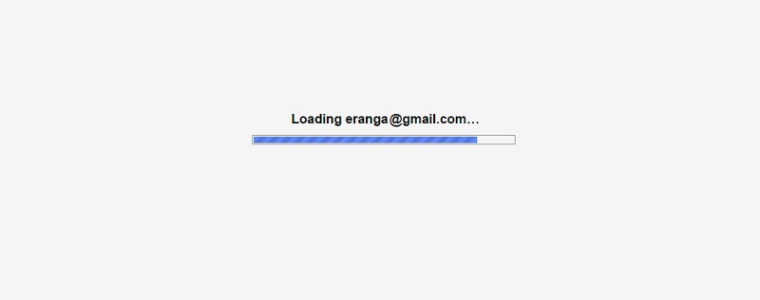


Slide 8
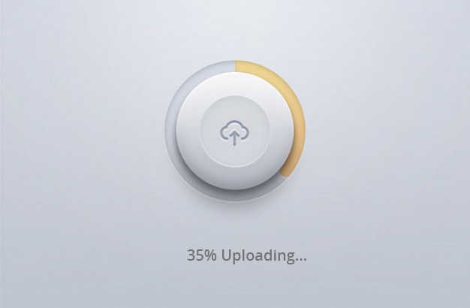

Button with Progress

Slide 9
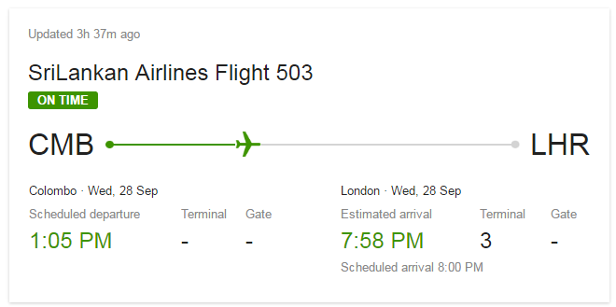
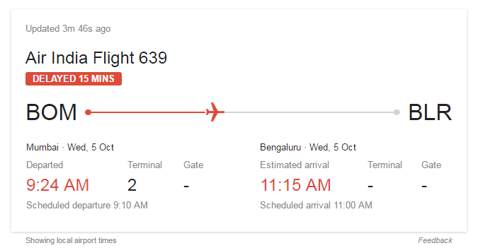
Flight details on google

Slide 10
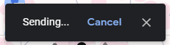
When you send an email with Gmail

Slide 11
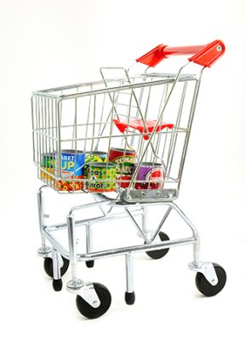


H2. Match between system and real world
Metaphor-What are you talking about?
The system should speak the users language, with words, and concepts that are familiar to the user

Slide 12
Requested credit card details are matched with a real credit card.

Slide 13

iBooks iPad application using the metaphor of wooden book shelf.

Slide 14
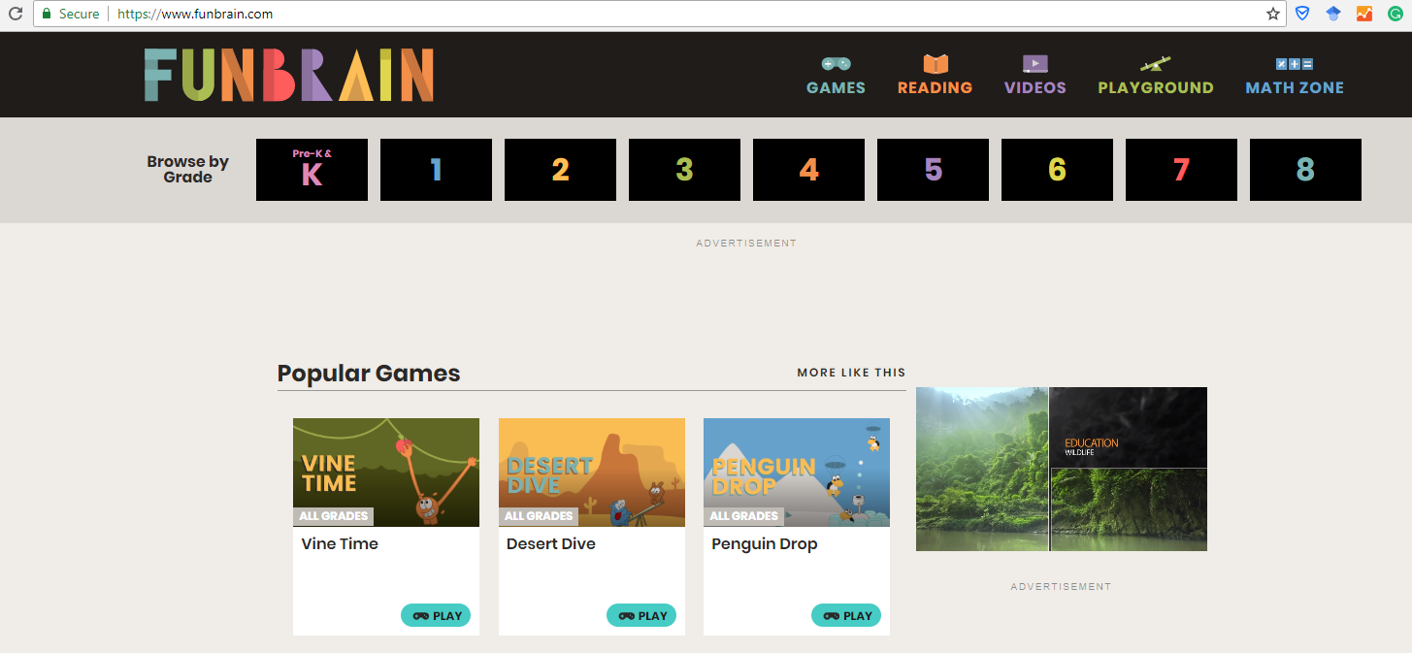
Kids’ Website should use kids’ words

Slide 15
H3. User control and freedom
Users often choose system functions by mistake and will need a clearly marked “emergency exit” to leave the unwanted state without having to go through an extended dialogue. Support undo and redo.
-Oops!

Slide 16
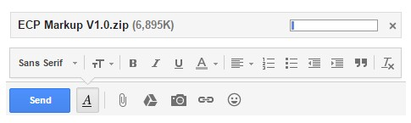
If you attached a large file in Gmail by mistakenly, you can cancel it before its fully uploaded.

Slide 17
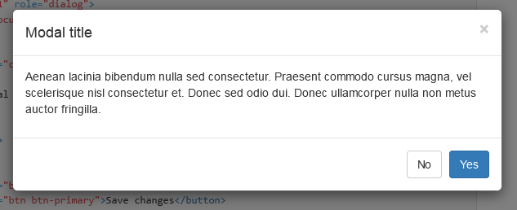
When you trigger an action accidentally, and you want to get out of there without going through any of the details, small cross is there to rescue you.

Slide 18
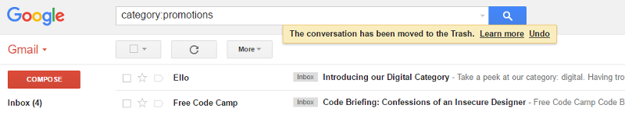
Gmail’s flash message with undo action when we accidentally delete an email.

Slide 19
H4. Consistency and standards
Users should not have to wonder whether different words, situations, or actions mean the same thing. Follow platform conventions.
-Oh, I know that!

Slide 20


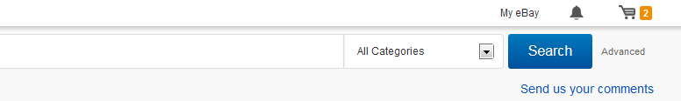
You will always find sign-in, profile details and shopping cart information at the top right corner.

Slide 21
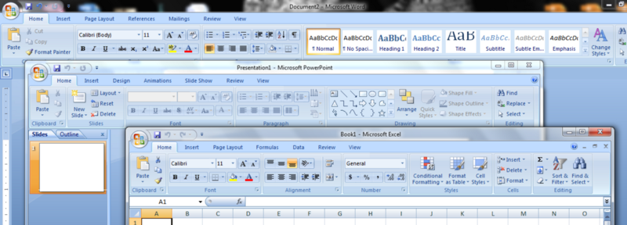
Microsoft Word, Excel, and PowerPoint all use the same style toolbar with the same primary menu options: Home, Insert, Page Layout…
Consistency results in efficiency and perceived intuitiveness

Slide 22
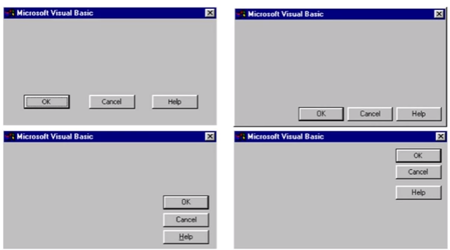
Violation of Consistency principle

Slide 23
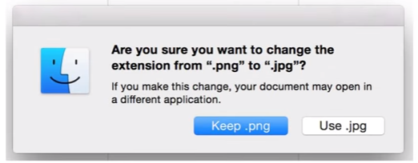


Slide 24
Ctrl + F in Outlook
Is used to reply an email

Slide 25
H5. Error prevention
Even better than good error messages is a careful design which prevents a problem from occurring in the first place. Either eliminate error-prone conditions or check for them and present users with a confirmation option before they commit to the action.

Slide 26
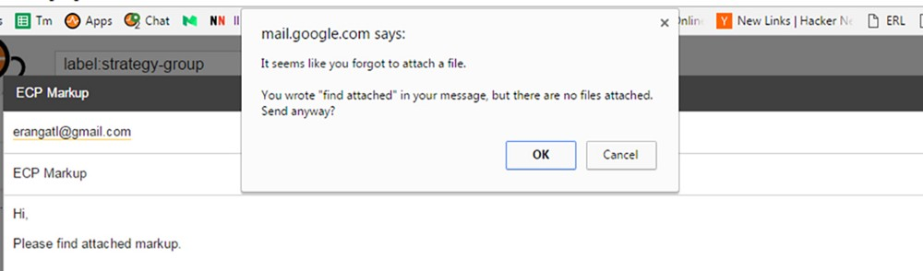
When you try to send an attachment through Gmail and forgets to attach it, Gmail smartly detects that you haven't attached the file and warn you before you send the mail.

Slide 27
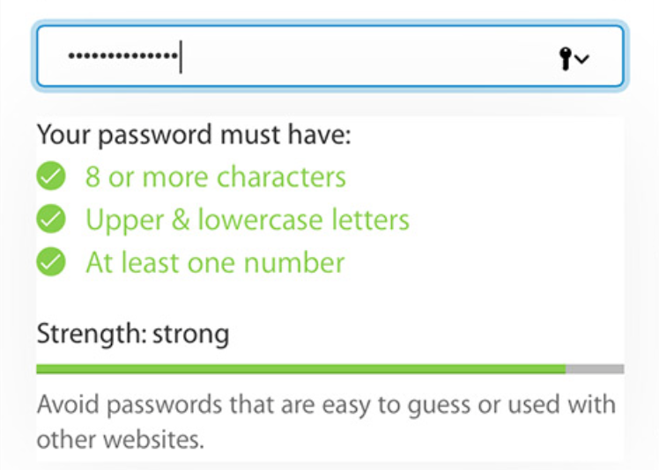
When you choose a password tips are provided to prevent errors and password strength is calculated and displayed as you type.

Slide 28
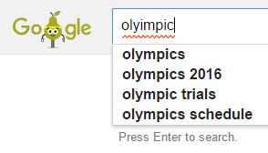
Google Search trying to correct spelling

Slide 29
H6. Recognition rather than recall
Minimize the user’s memory load by making objects, actions, and options visible. The user should not have to remember information from one part of the dialogue to another. Instructions for use of the system should be visible or easily retrievable whenever appropriate.

Slide 30
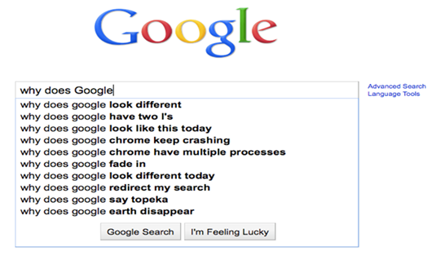
When you google it gives you list suggestions as you type in based on your previous searches and related most searches. It also lists your matching bookmarks as well.

Slide 31
H7. Flexibility and efficiency of use
Accelerators — unseen by the novice user — may often speed up the interaction for the expert user such that the system can cater to both inexperienced and experienced users. Allow users to tailor frequent actions.

Slide 32
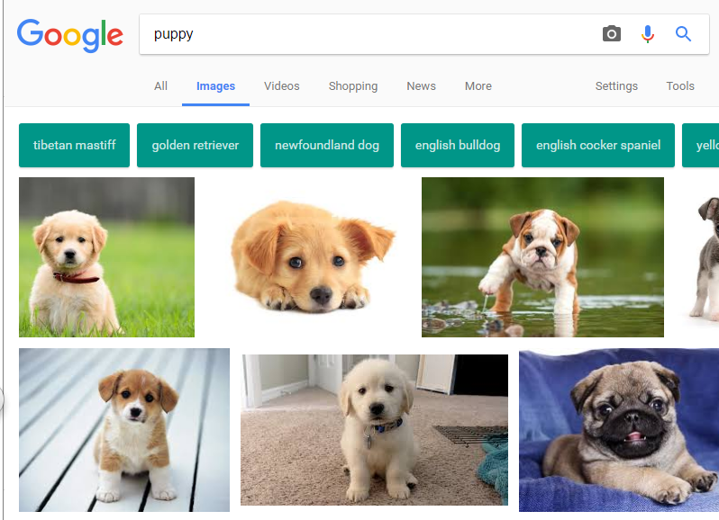

Slide 33
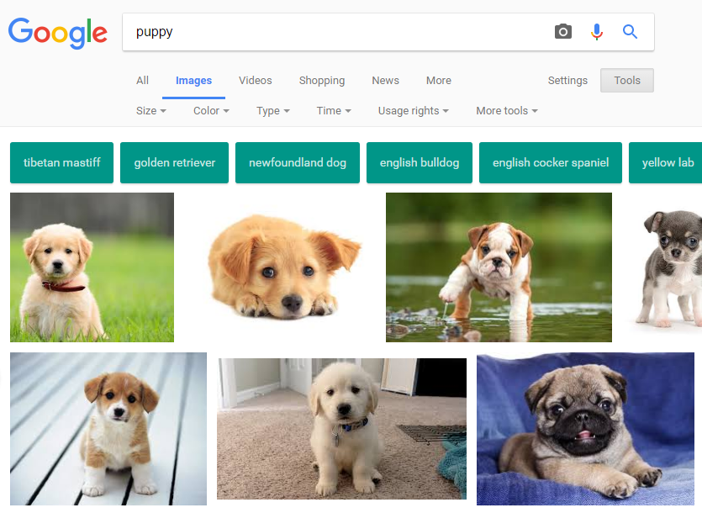
Advanced users can use the filter

Slide 34
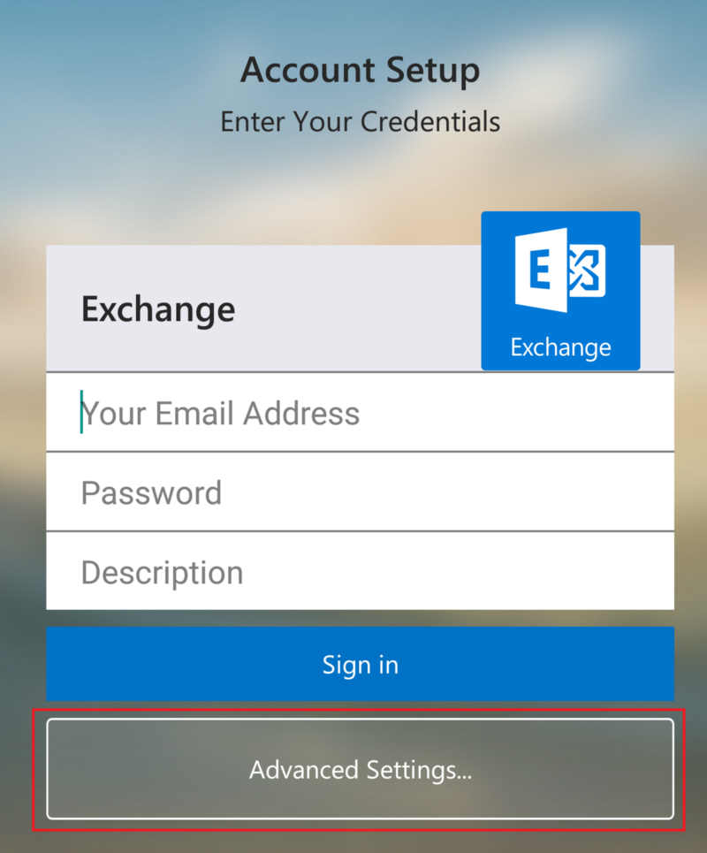
Setting up Exchange on Android
Hide the complex features under Advanced

Slide 35
H8. Aesthetic and minimalist design
Dialogues should not contain information which is irrelevant or rarely needed. Every extra unit of information in a dialogue competes with the relevant units of information and diminishes their relative visibility.

Slide 36
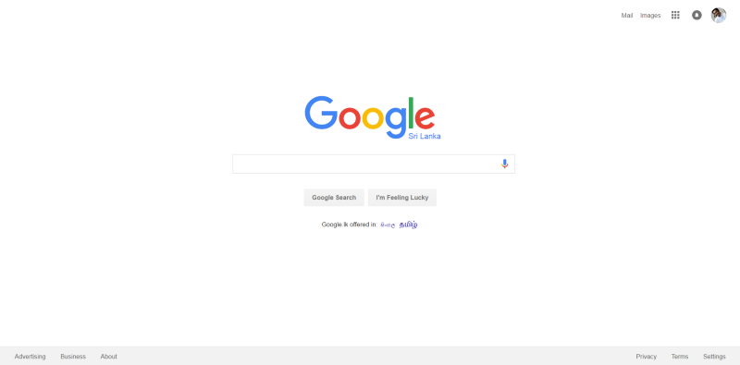

Slide 37
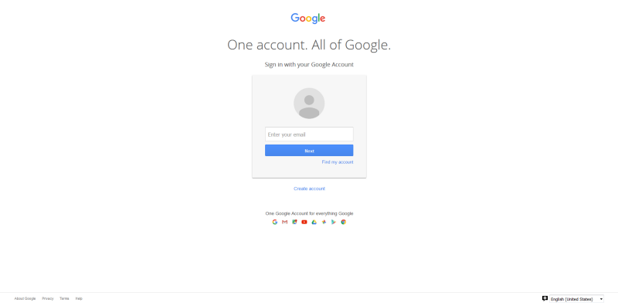

Slide 38
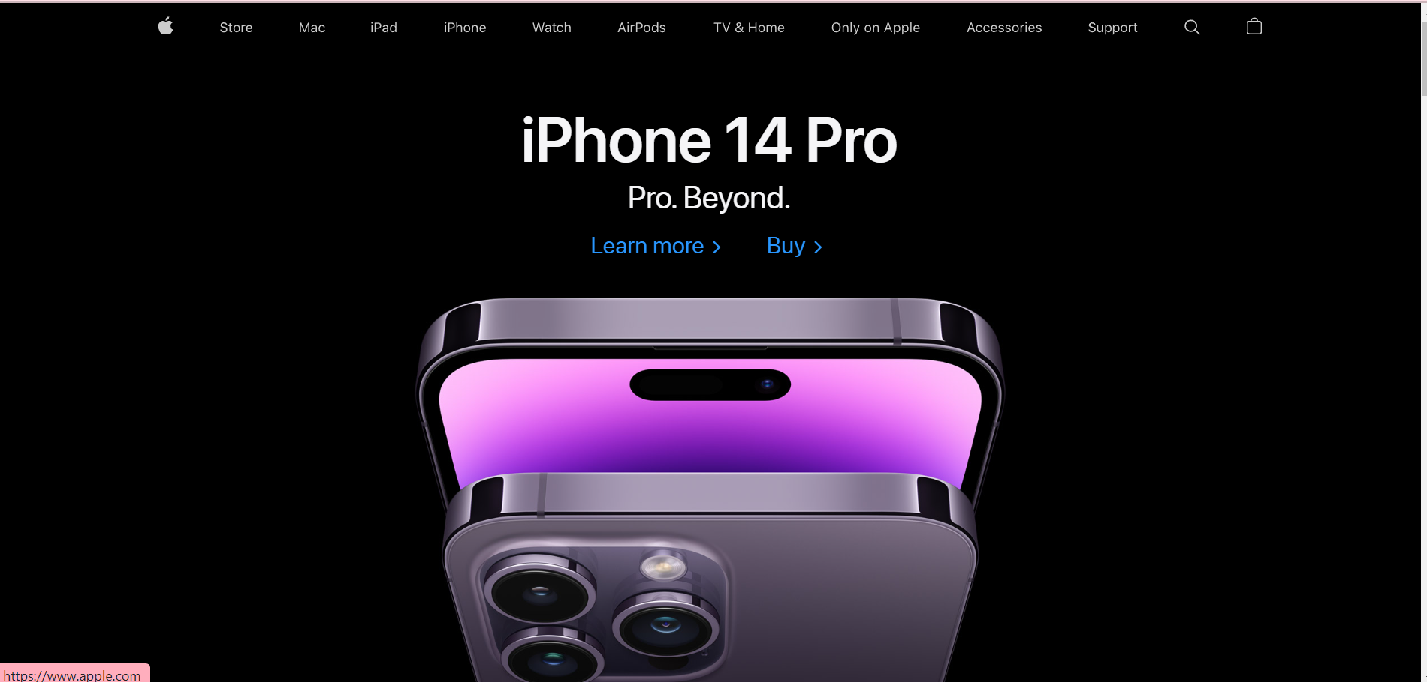
Apple provides only the basic information of feature hiding additional information under “Learn More”.

Slide 39
H9. Help users recognize, diagnose, and recover from errors
Error messages should be expressed in plain language (no codes), precisely indicate the problem, and constructively suggest a solution.

Slide 40
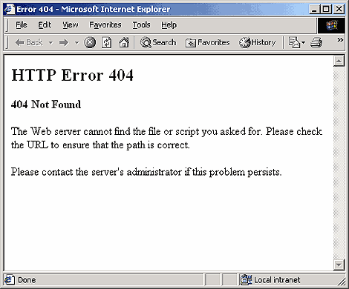

Slide 41
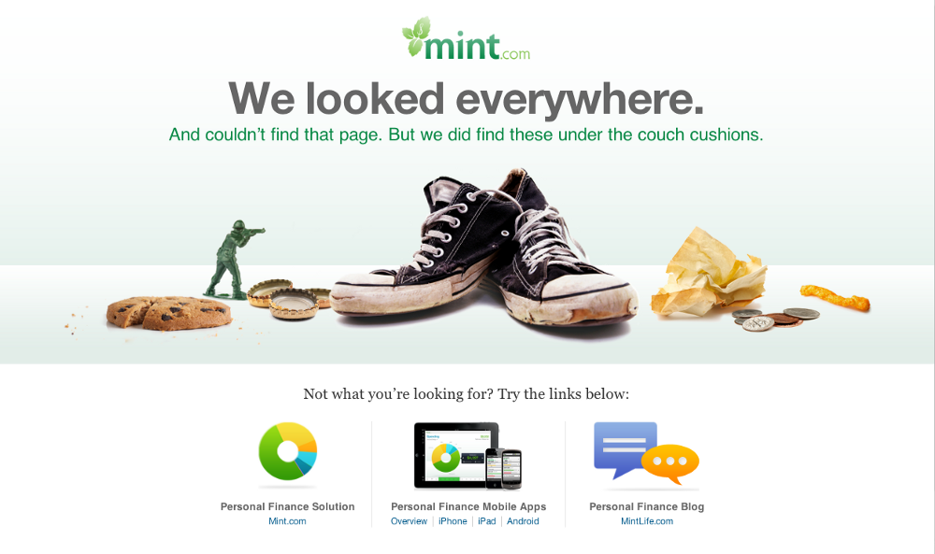
This funny error message keeps the audience engaged, while relevant links keep you on your website.

Slide 42
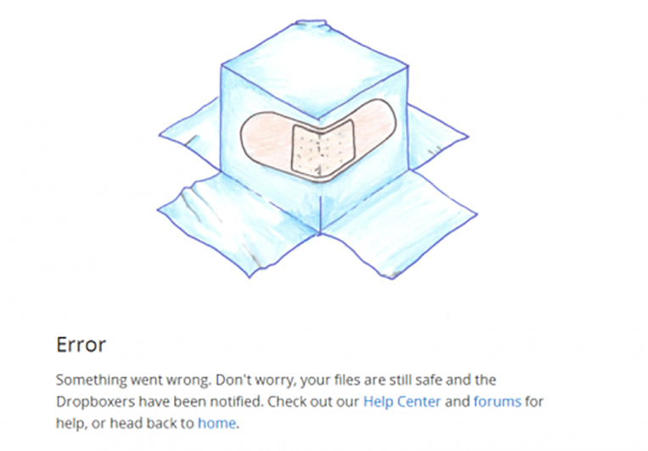
When there is an error you should not panic user, you need to help them recover by suggesting a solution. This error message assures you are safe and suggest some alternative links.
Notes:
Another example from http://temp.163.com/special/404_page02/

Slide 43
H10. Help and documentation
Even though it is better if the system can be used without documentation, it may be necessary to provide help and documentation. Any such information should be easy to search, focused on the user’s task, list concrete steps to be carried out, and not be too large.

Slide 44
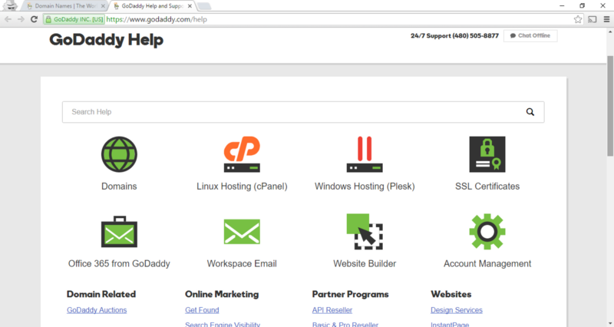
An example of GoDaddy’s Help page. While there is a search field, there are main categories and frequently asked queries on the same page.

Slide 45
How to Perform H.E.
At least two passes for each evaluator
first to get feel for flow and scope of system
second to focus on specific elements
Assistance from implementers/domain experts
If system is walk-up-and-use or evaluators are domain experts, then no assistance needed
Otherwise might supply evaluators with scenarios and have implementers standing by
Individuals evaluate and then aggregate results

Slide 46
Example Problem Descriptions
Can’t copy info from one window to another
Violates “Recognition rather than recall” (H6)
Fix: allow copying
Typography uses mix of upper/lower case formats and fonts
Violates “Consistency and standards” (H4)
Slows users down
Fix: pick a single format for entire interface

Slide 47
Severity Ratings
Used to allocate resources to fix problems
Estimates of need for more usability efforts
Combination of
frequency
impact
persistence (one time or repeating)
Should be calculated after all evaluations are done
Should be done independently by all evaluators, and then as a group

Slide 48
Severity Ratings (from Nielsen & Mack 94)
0 - don’t agree that this is a usability problem
1 - cosmetic problem
2 - minor usability problem
3 - major usability problem; important to fix
4 - usability catastrophe; imperative to fix

Slide 49
Severity Ratings Example
1. [H4 Consistency] (Severity 3)
The interface used the string "Save" on the first screen for saving the user's file, but used the string "Write file" on the second screen. Users may be confused by this different terminology for the same function.

Slide 50
Debriefing
Conduct with evaluators, observers, and development team members
Discuss general characteristics of UI
Suggest potential improvements to address major usability problems
Dev. team rates how hard things are to fix
Make it a brainstorming session

Slide 51
Results of Using HE (cont.)
Single evaluator achieves poor results
only finds 35% of usability problems
5 evaluators find ~ 75% of usability problems
why not more evaluators? 10? 20?
adding evaluators costs more
adding more evaluators doesn’t increase the number of unique problems found

Slide 52
Team Homework: Heuristic Evaluation Report (10/5)
5-6 people in a team, choose a website with a bad design to work on (include everyone’s name and a link to the website in your report)
Evaluation from EACH evaluator for 5 webpages (the same 5 pages for all evaluators) of the website you chose to work on
1) Write a report including the following (due 10/5)
Evaluation from EACH evaluator (images with issues circled to accompany each problem if possible)
Aggregated evaluation from all evaluators
Individual severity rating
Aggregated severity rating
Images with issues circled to accompany each problem with 3 or 4 severity
2) Present the issues you find on 10/5 in class
Peer evaluation will be conducted
Only one submission is needed for each team

Slide 53
Reminder
Individual Assignment3-card sort (due 9/21)

